Slide 1
KCBFOTC Meeting
February 18, 2020
Presented by:
Buddy Kuhn
City Manager

Slide 2
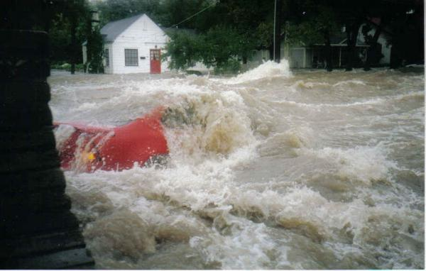
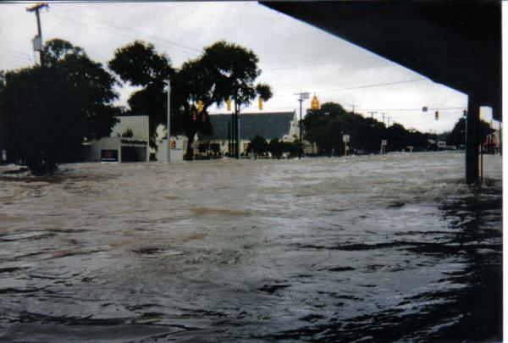
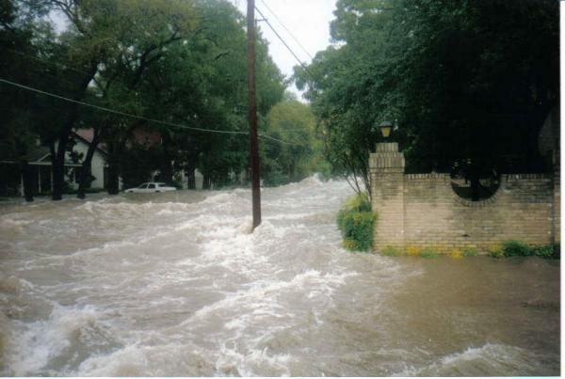
1998 Flood Event – Lower Broadway

Slide 3
2018 Flood Event – Lower Broadway

Slide 4
Current Environment and Scope Development
Significant flooding
TxDOT ownership of Broadway – Austin Hwy to Burr
Aging water & sewer lines
Deteriorated sidewalks, curbs and drainage inlets
No Bike lanes
ADA issues

Slide 5
Background
2017
MPO awards $10M for multi-modal project
TxDOT awards $4M for reconstruction of roadway and traffic signals
TxDOT Holds Stakeholder Meetings #1 & #2
2018
TxDOT provides initial scope and budget - $34.4 million
COAH commissions economic impact study – Steve Nivin, SABER Institute
2019
Stakeholder Meeting #3
Parking Study - lower Broadway and school areas
Streetscape Design & Renderings - Overland Partners
Monthly meetings - COAH , TxDOT and LJA Engineers
City Council Workshop

Slide 6
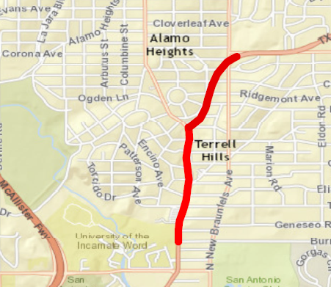
Project Scope Overview
Lower Broadway – 0.7 mile (Austin Hwy to Burr)
Streets
Sidewalks & Bike Lane
Storm water drainage
Underground utilities (water, sewer)
Landscaping
Broadway and Austin Highway total length – 1.13 miles

Slide 7
TxDOT Cost Estimates – Oct. 2018
Scope | Amount
Roadway – Austin Hwy to Burr | $12,667,047
Regional Storm water | $13,710,451
Landscaping | $945,424
Utilities (underground & burial) | $7,160,000
TOTAL: | $34,483,283

Slide 8
Street Improvements
New Traffic/Crosswalk Signals
Create consistencies
Existing northern Broadway configuration
Extension of COSA Broadway project to south
Turn Back Program
COAH to assume ownership of ROW
Funded 100% by TxDOT

Slide 9
Sidewalk Improvements
Widen Sidewalks
Increase pedestrian mobility
Multi-modal
Bike lanes
Extension of COSA Broadway Project
Parking changes
Primarily funded by the MPO

Slide 10
Storm water Improvements
Improve to 25-year Flood Plain
Remove 29+/- acres from flood plain
15% increase in property tax value*
Addresses regional storm water issues
Funded by COAH General Obligation Bonds
Fund Leveraging with Bexar County
*est. $10.9M impact to GF over 20 years per Economic Impact Study

Slide 11
Underground Utilities
City of Alamo Heights Water & Sewer Lines
Aging infrastructure
Roadway already under construction
De-conflict with new storm drainage
Funded 100% by COAH Utilities Fund Certificates of Obligation
Underground Duct Bank
Allow for utility relocation for future developments
Unfunded – design alternate if funding secured

Slide 12
Landscaping
Low Impact Development Landscaping
Captures and slows down storm water
Improves quality of run-off at San Antonio River Headwaters
Funded 100% by San Antonio River Authority
Infrastructure for future Landscaping & Streetscape
Irrigation, electrical and minimal plantings

Slide 13
BROADWAY @ TERREL

Slide 14
BROADWAY @ BARILLA

Slide 15
Project Coordination
Continue monthly meetings with TxDOT
Environmental Study
Constructability assessment
Ability to include scope within ROW
Design Documents
Construction phasing
Minimize impact to residents and businesses
Avoiding complete closures

Slide 16
Funding Responsibility
Street & Sidewalks
MPO & TxDOT
Storm Water Drainage
City of Alamo Heights
Utilities
City of Alamo Heights
Water/Sewer Lines
Landscaping
SARA
Low Impact Design - to be included in SARA’s FY21 Budget
City of Alamo Heights
Infrastructure and minimal plantings
ESTIMATED PROJECT COST:
$31,628,951

Slide 17
Funding Gap
SOURCES | SCOPE | COMMITTED
MPO | Road, Bike Lane, Sidewalks | $10,000,000
TxDOT | Roadway | $4,000,000*
SARA | LID Landscaping | $1,300,500
 | SUB TOTAL: | $15,300,500
PROJECT COST SUMMARY
PROJECT COSTS: | $31,628,951
PROJECT GAP: | $16,328,451
* TxDOT also absorbing all costs related to cost estimates, design, engineering, environmental and project management.

Slide 18
City of Alamo Heights Resources
Project Construction Costs
General Obligation Bonds - $13.25M
Funded by ad valorem tax increase
Utility Fund Certificates of Obligation - $2.1M
Funded by Water/Sewer rates
Project Contingency Costs
General Fund Balance earmark FY21- FY25 - $978,000

