Slide 1
AAMPO Regional Transportation Models
San Antonio Multi-Modal Models (2019)
SAMM Version 4.1
TransCAD 8.0
Notes:
SAMM V3 contains the recent upgrades through VIA’s contract with Cambridge Systematics… including a Destination Choice distribution model and speed feedback loops.

Slide 2
Opening the Black Box

Slide 3
Travel Demand Model forecasts demand/supply
Travel Demand (VMT) /
Transportation System Supply (Network Capacity)
Can be stratified by Region, County, City, Travel Corridor or Time-of-Day

Slide 4
Evaluating 24-hr V/C Ratios
Volume/Capacity= LOS
0.00 to 0.33 A
0.33 to 0.55 B
0.55 to 0.75 C
0.75 to 0.90 D
0.90 to 1.00 E
1.00 & up F

Slide 5
Model Coverage
5 Counties: Bexar, Comal,
Guadalupe, Kendall & Wilson
1-1,317 Internal Traffic Analysis Zones (TAZ)
42 External Stations

Slide 6
7-County Region with Atascosa & Medina

Slide 7
Current Model Cycle
● Last Year of 4/5-year 2045 MTP update (2015-2018/2019)
● New TDM update for 2020
● Saturation Counts & Transit On-board (2015/2020), US Census
● Comprehensive Surveys (2018-2020)
Household / Workplace
Externals / Commercial Truck
Vehicle Classification
● Model Re-calibration & Validation (2021-2022)… Forecasts for 2030, 2040 & 2050.

Slide 8
TDM Input Data
2020, 2030, 2040 & 2050
(1) TAZ Level Demographics
● Population, Households
● Employment. (Basic, Retail, Service, Edu1 & Edu2)
● HH Income, Workers & Autos (2) Highway Networks (collector & higher FC)
(3) Transit Networks

Slide 9
Trip Purposes
● Why segment trips by Trip Purpose?
● What trip purposes do we use?
HBW (P) NHB (P)
HBNW-Retail (P) NHB-S (P)
HBNW-Other (P) Truck (V)
HBNW-Ed1 (P) Exlo-Truck (V)
HBNW-Ed2 (P) Exlo-NC (V)
NW-Airport (P) External-Thru (V)
● Which trip purpose contributes the largest proportion to daily VMT?

Slide 10
Daily Trip Making & VMT
Daily (24-hr) Trip Making (5 County Region)
 |  | 2020 | 2020 |  | 2020 | 2020
Trip Purpose |  | Person Trips | Vehicle Trips | Ratio | ATL (miles) | VMT | %
HBW |  | 1,593,900 | 1,443,900 | 1.10 | 10.5 | 15,160,950 | 24%
HBNW-Retail |  | 1,920,400 | 1,318,500 | 1.46 | 6.0 | 7,911,000 | 12%
HBNW-Other |  | 1,480,300 | 944,800 | 1.57 | 7.5 | 7,086,000 | 11%
HBNW-ED1 |  | 1,682,200 | 636,300 | 2.64 | 4.7 | 2,990,610 | 5%
HBNW-ED2 |  | 153,000 | 132,600 | 1.15 | 11.5 | 1,524,900 | 2%
NHB |  | 2,594,700 | 1,784,400 | 1.45 | 6.5 | 11,598,600 | 18%
NHB-Special |  | 621,700 | 428,800 | 1.45 | 6.0 | 2,572,800 | 4%
NW-Airport |  | 39,700 | 26,500 | 1.50 | 16.5 | 437,250 | 1%
Truck-Commercial |  |  | 635,000 |  | 7.4 | 4,699,000 | 7%
Exlo-Commercial |  |  | 81,600 |  | 17.8 | 1,452,480 | 2%
Exlo-NonCommercial |  |  | 343,200 |  | 21.6 | 7,413,120 | 12%
Ext- Thru |  |  | 23,500 |  | 37.5 | 881,250 | 1%
TOTAL |  |  | 7,799,100 |  |  | 63,727,960

Slide 11
Trips by Purpose over Time

Slide 12
TDM Applications
Evaluate Demographic & Transportation Alternatives. Prioritize Projects.
Estimate & Forecast Traffic for CMP and Design-Level Traffic.
Estimate & Forecast Transit for FTA New Starts/Small Starts funding.
Export Transportation Data for Subarea & Corridor Studies.
Interface with On-road Emissions Software (Moves2010b) for Air-shed & Conformity.

Slide 13
What Kind of Model Do We Have ?
● Four Step Aggregate (TAZ) Macro-Level Model for Typical Weekday Travel.
● Trip Based (1,359x1,359) sized matrix… 1.85 million zone pairs.
● Produces 24-Hour and for 4 Times of Day
Travel… AM-Peak, Midday, PM-Peak & Overnight.
1. Trip Generation (Tripcal5)
2. Trip Distribution (Destination Choice)
3. Mode Choice (Nested Logit)
4. Traffic & Transit Assignment

Slide 14
Travel Demand Model Flowchart

Slide 15
Evaluating 24-hr V/C Ratios
Volume/Capacity= LOS
0.00 to 0.33 A
0.33 to 0.55 B
0.55 to 0.75 C
0.75 to 0.90 D
0.90 to 1.00 E
1.00 & up F

Slide 16
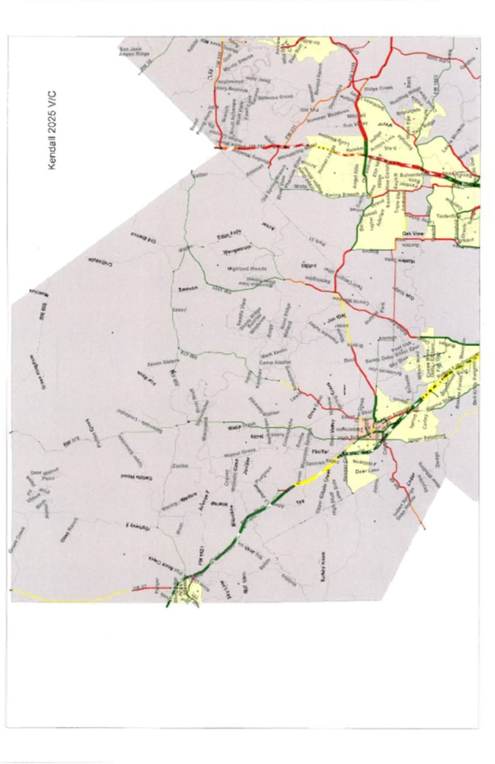

Slide 17
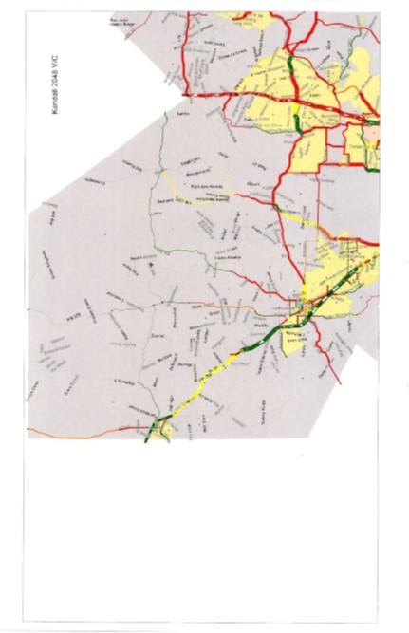

Slide 20
End

