Slide 1
TRANSPORTATION ISSUES
County Transportation Plan would be helpful
Connectivity due to physical gates is an issue for pedestrians and motorists
Major development on SH 46, west of IH-10
Miralomas and Spencer Ranch will add approximately 1,200-1,400 single family homes
City of Boerne and Boerne ISD to discuss parking improvements can be made on Esser Road
Ped/bike path between Esperanza/Bentwood to allow children to walk to Herff Elementary
Current closure of Cascade Caverns at IH-10 Frontage Road has made traffic easier for vehicles turning left from Old San Antonio Road to Cascade Caverns
Signage improvements at FM 3351 and SH 46 to direct motorists to IH-10
Additional study involving Main Street merchants to help identify Main Street Alternatives
Further discussion with AAMPO regarding crowdsource data.
DRAFT
Kendall County, Boerne & Fair Oaks Transportation Committee

Slide 2
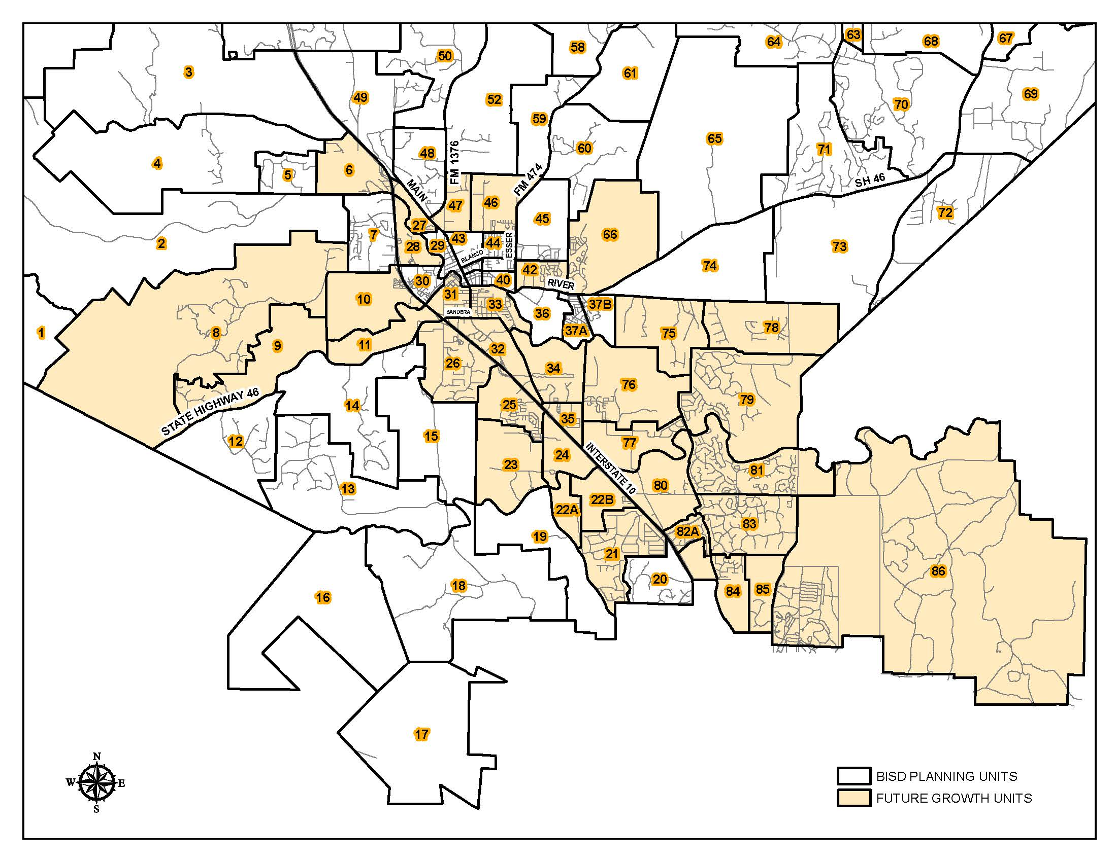
DRAFT
Kendall County, Boerne & Fair Oaks Transportation Committee

Slide 3
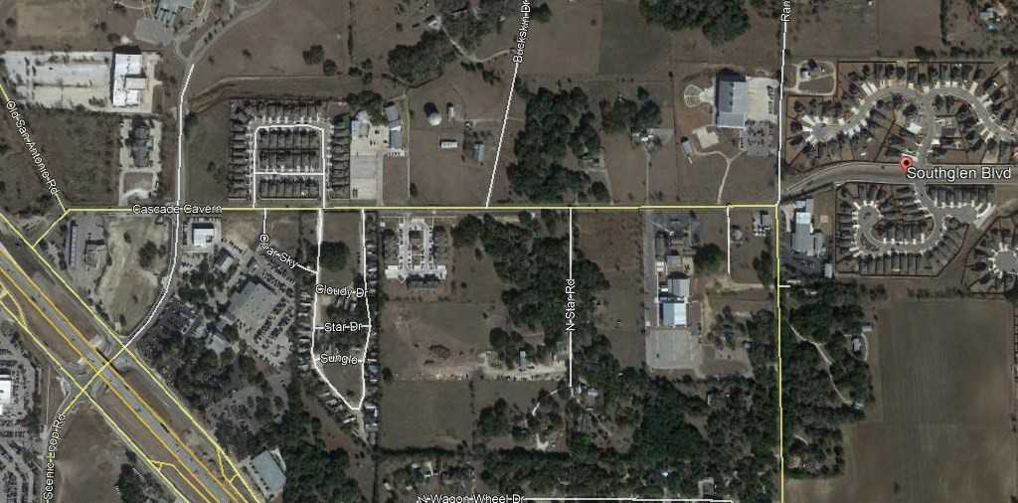
BOERNE MIDDLE SCHOOL SOUTH
CASCADE CAVERNS ROAD IMPROVEMENTS
From IH-10 to Southglen Blvd
SE Quadrant
CASCADE CAVERNS ROAD
Phase I Improvements, from IH-10 to Buckskin Dr (Boerne Middle School South), has been submitted to AAMPO for funding
Phase II from Boerne Middle School South to Southglen Blvd
Old San Antonio Road from Herff Road to Cascade Caverns will include a TWLTL
IH-10
Long Term:
Short Term:
Add Center-turn Lane
Add Center-turn Lane
Additional lane in each direction
Add Sidewalk and Bike Lanes in each direction
DRAFT
Kendall County, Boerne & Fair Oaks Transportation Committee

Slide 4
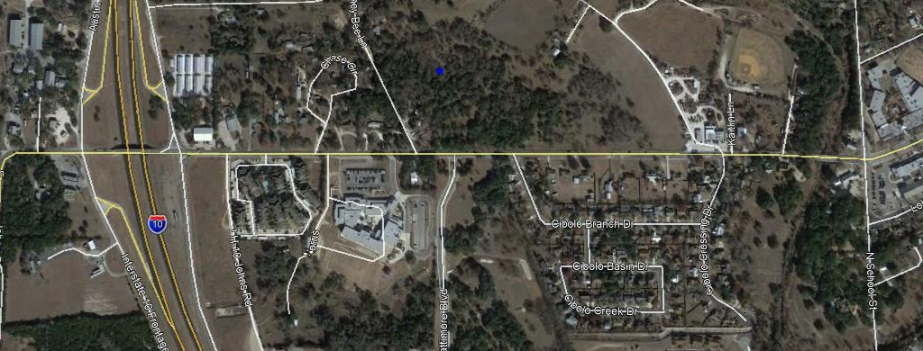
JOHNS ROAD IMPROVEMENTS
From IH-10 to School Street
NE Quadrant
Capital Improvement Project 2017-2021
Phase I: Add center turn lane within existing ROW
Phase II: Add bike and pedestrian facilities on one side of Johns Road
JOHNS ROAD
IH-10
FABRA ELEMENTARY SCHOOL
SCHOOL ST
Short Term:
Add Center-turn Lane
Long Term:
Add Sidewalk and Bike Lane in one direction
DRAFT
Kendall County, Boerne & Fair Oaks Transportation Committee

Slide 5
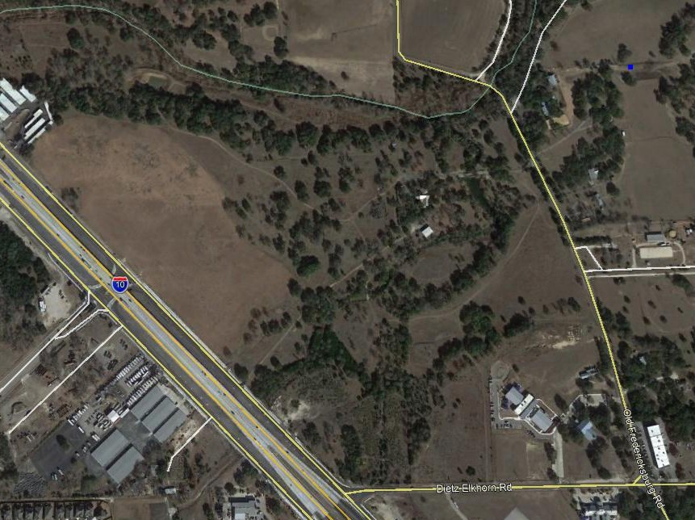
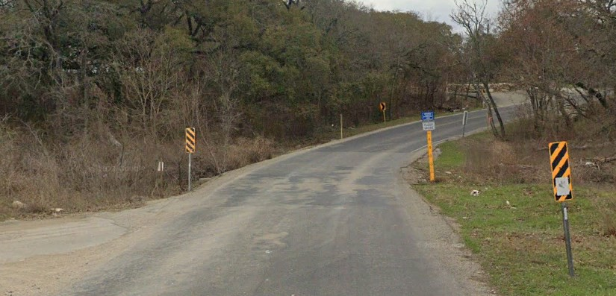
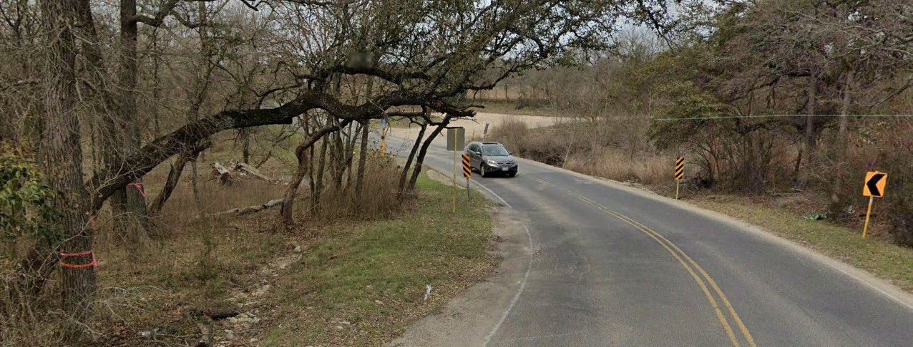
OLD FREDERICKSBURG RD LOW WATER CROSSING IMPROVEMENT
LOW WATER CROSSING
SE Quadrant
Improve low water crossing at Kendall/Bexar County Line with structure sufficient to handle 10-yr storm event to be made by Lemon Creek Development
Requires coordination and partial funding from Bexar County
Safety/Operational Improvement
Motorist must turn around and use Cascade Caverns Rd when roadway is impassable
IH-10
DIETZ ELKHORN RD
Current Configuration, SB approach
Current Configuration, NB approach
DRAFT
Kendall County, Boerne & Fair Oaks Transportation Committee

Slide 6
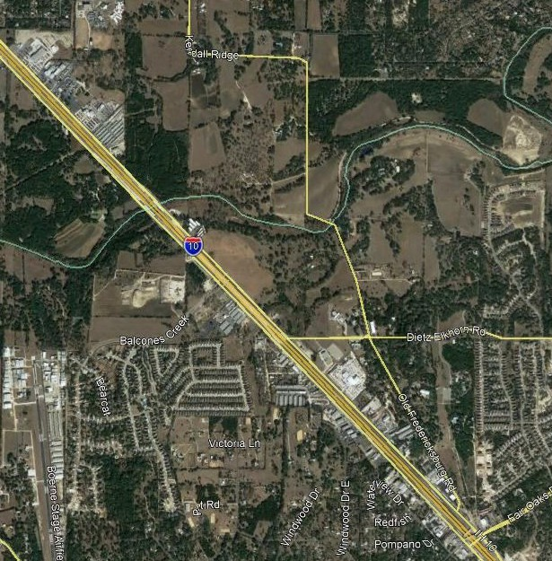
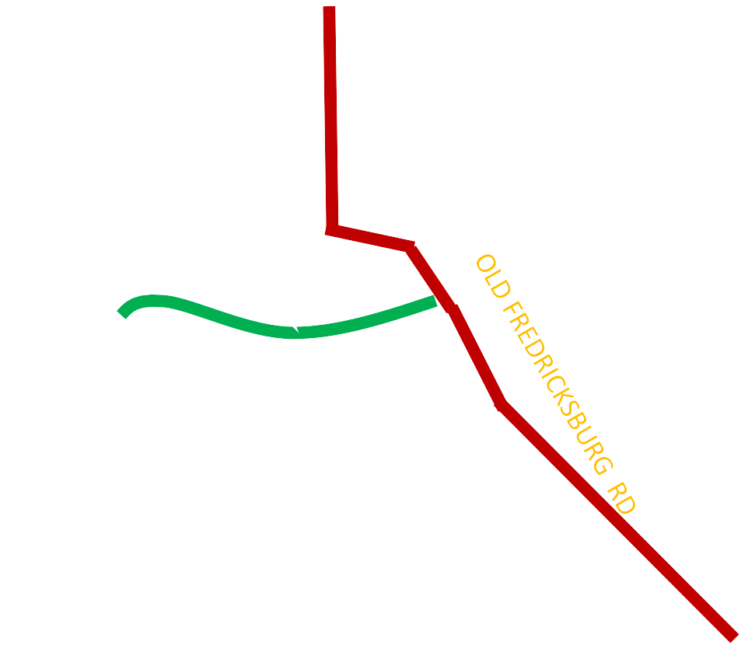
Old Fredericksburg Roadway Improvements From Kendall Ridge to IH-10
KENDALL RIDGE
SE Quadrant (Bexar County)
Proposed connection built for by the Lemon Creek Development
NOT PROPOSED ALIGNEMENT
ILLUSTRATION PURPOSES ONLY
IH-10
Two Projects
Project 1: Old Fredericksburg Improvements
Short Term: Add center turn lane?
Long Term: Add left-turn-bays and acceleration lanes to service development
Project 2: Add connection from Balcones Creek to Old Fredericksburg Road
BALCONES CREEK
DIETZ ELKHORN
Short Term:
Add Center-turn Lane
Long Term:
Add Sidewalk and Bike Lane in one direction
DRAFT
Kendall County, Boerne & Fair Oaks Transportation Committee

Slide 7
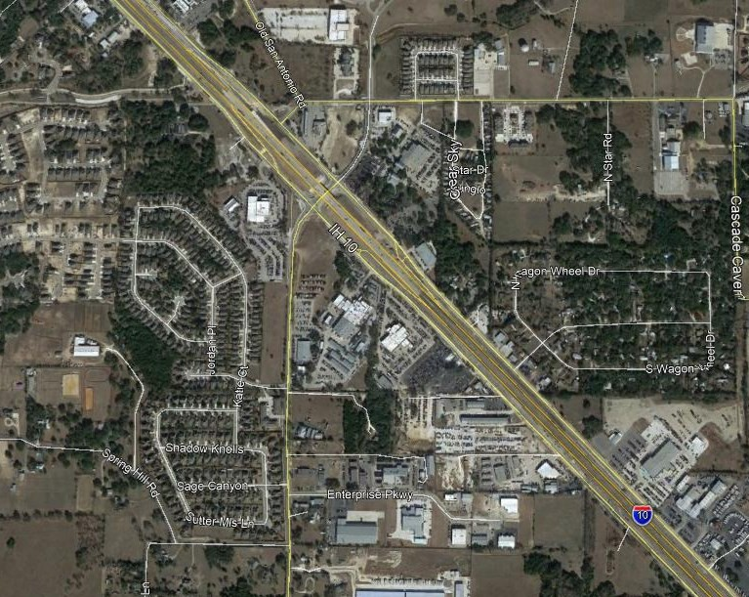
Scenic Loop Rd/Enterprise Pkwy Improvements
From Kendall Ridge to IH-10
SW Quadrant
Two Separate Long Term Projects
Capital Improvement Projects, 2017-2021
Project 1: Connect Enterprise Pkwy to IH-10 frontage road
Would remove traffic from IH-10/Scenic Loop Interchange
Project 2: Widen Scenic Loop from Sophia Circle to IH-10
Coordination between the City of Boerne, Kendall/Bexar, and
SCENIC LOOP RD
SOPHIA CIRCLE
IH-10
ENTERPRISE PKWY
Long Term:
Add center turn lane
Add sidewalk and bike Lane in one direction
NOT PROPOSED ALIGNEMENT
ILLUSTRATION PURPOSES ONLY
DRAFT
Kendall County, Boerne & Fair Oaks Transportation Committee

Slide 8
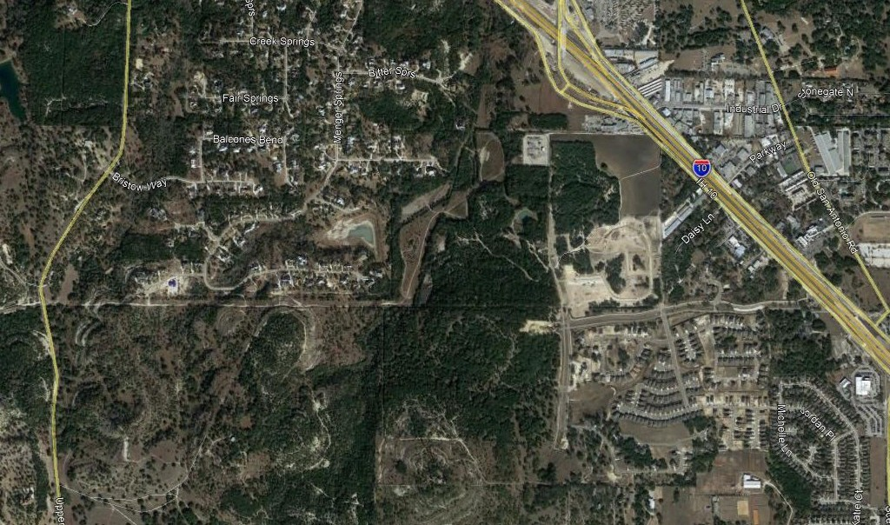
Regent Blvd Connection
From IH-10 to Upper Balcones Rd
SW Quadrant
City of Boerne development agreement with Regent Park calls for an east/west major arterial, Regent Blvd
IH-10
Regent Park provided ROW for arterial, ends at Menger Springs
ROW provided in Menger Springs for arterial
MENGER SPRINGS
NOT PROPOSED ALIGNEMENT
ILLUSTRATION PURPOSES ONLY
Proposed project would require ROW to make connection
ROW NEEDED
NOT PROPOSED ALIGNEMENT
ILLUSTRATION PURPOSES ONLY
UPPER BALCONES
Regent Blvd Typical Section:
DRAFT
Kendall County, Boerne & Fair Oaks Transportation Committee

Slide 9
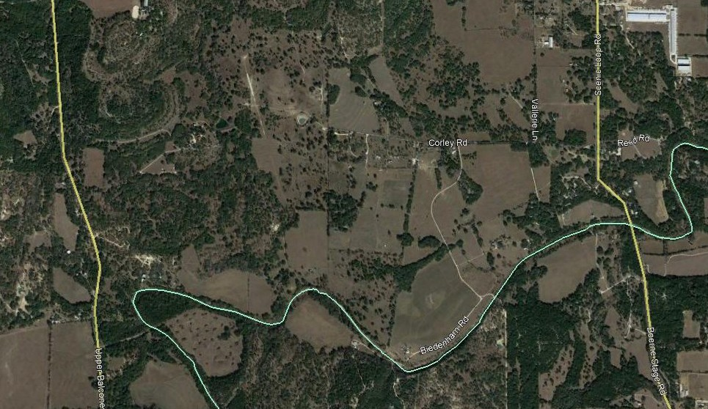
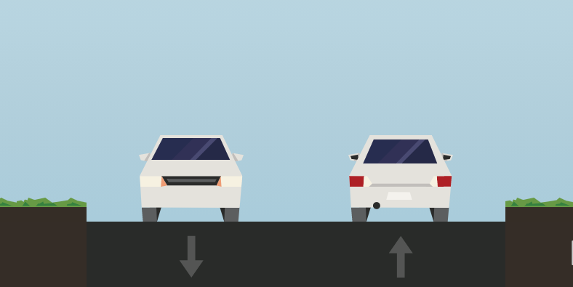
CORLEY FARMS ROAD CONNECTION TO UPPER
UPPER BALCONES RD
NOT PROPOSED ALIGNEMENT
BALCONES RD & VALERIE LANE ROAD SHARED USE PATH
ILLUSTRATION PURPOSES ONLY
SCENIC LOOP RD
CORLEY FARMS RD PROPOSED SCHOOL
SW Quadrant
Two Projects
Project 1: Corely Road Connection
City of Boerne development agreement calls for a east/west collector to connect Scenic Loop Rd to Upper Balcones Rd.
Project 2: Shared Use Path (SUP) from Kendall Estates to Valerie Lane thru Biedenharn Development
Pedestrians, primarily students, would not have to access Scenic Loop Rd if connection was made
Safe Path to School funding may be available for
this project
DRAFT
Corley Rd Existing Typical Section:
Corley Rd Proposed Typical Section:
Kendall County, Boerne & Fair Oaks Transportation Committee

Slide 10
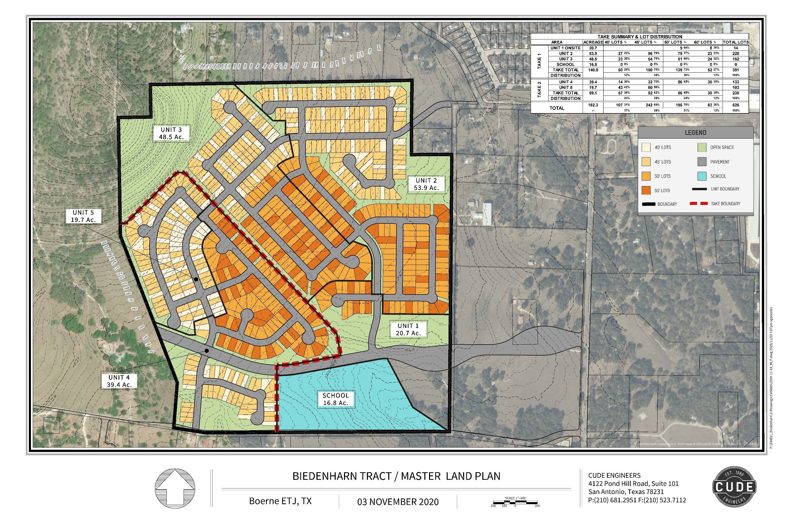
VALERIE LANE ROAD SHARED USE PATH
DRAFT
Kendall County, Boerne & Fair Oaks Transportation Committee

Slide 11
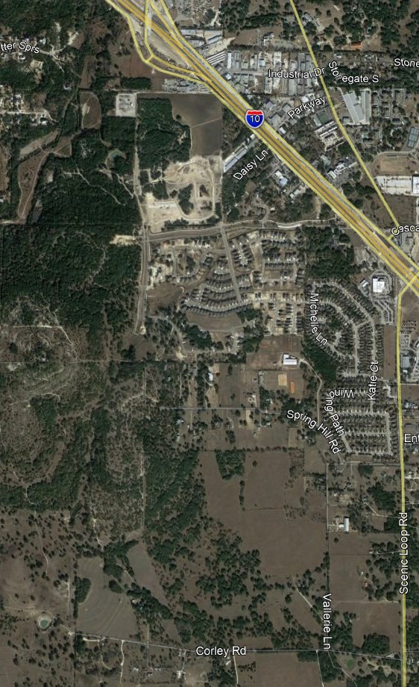
Regent Park/Biedenharn Connection to South Main
BUC-EE’S
SW Quadrant
East/West connector in Biederharn Development to connect with North/South Regent Park connector
IH-10
Development Agreement is in place with Biedenharn development for East/West arterial
NOT PROPOSED ALIGNE- MENT
ILLUSTRATION PURPOSES
ONLY
North/South connector is part of developer agreement between City of Boerne/Buc-ee’s/Regent Park
A development agreement is needed to complete the North/South connection
NOT PROPOSED ALIGNEMENT
ILLUSTRATION PURPOSES ONLY
SCENIC LOOP RD
Proposed Typical Section:
BIEDENHARN TRACT
NOT PROPOSED ALIGNEMENT
ILLUSTRATION PURPOSES ONLY
DRAFT
Kendall County, Boerne & Fair Oaks Transportation Committee

Slide 12
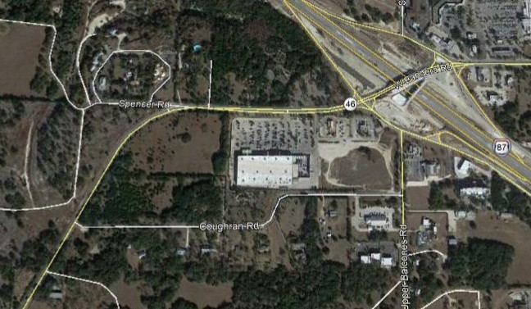
SH 46/Coughran Rd Improvements
SW Quadrant
Add signal and turn lanes to intersection, part of developer agreement
Coughran Rd connects SH 46 to Upper Balcones Rd
With construction on-going at SH 46/IH-10,
traffic volumes will increase on Coughran Rd
IH-10
SH 46
NOT PROPOSED ALIGNEMENT
ILLUSTRATION PURPOSES ONLY
COUGHRAN RD
Current Configuration on SH 46 at Coughran Road:
Long Term: Add signals and turn-lanes on SH 46 at Coughran Road
DRAFT
Kendall County, Boerne & Fair Oaks Transportation Committee

Slide 13
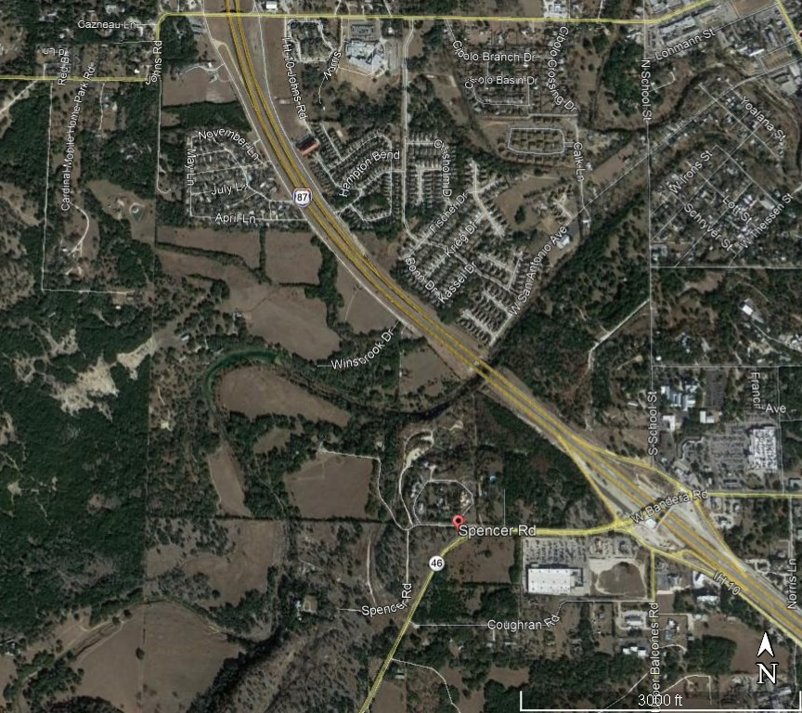
SPENCER RANCH ROAD CONNECTION
JOHNS RD
From SH 46 to Johns Road
NW Quadrant
City of Boerne has developer agreement to connect Spencer Road between SH 46 and Johns Road
IH-10
NOT PROPOSED ALIGNEMENT
ILLUSTRATION PURPOSES ONLY
SPENCER RD
Proposed Typical Section for Spencer Ranch Road:
SH 46
NOT PROPOSED ALIGNEMENT
ILLUSTRATION PURPOSES ONLY
DRAFT
Kendall County, Boerne & Fair Oaks Transportation Committee

Slide 14
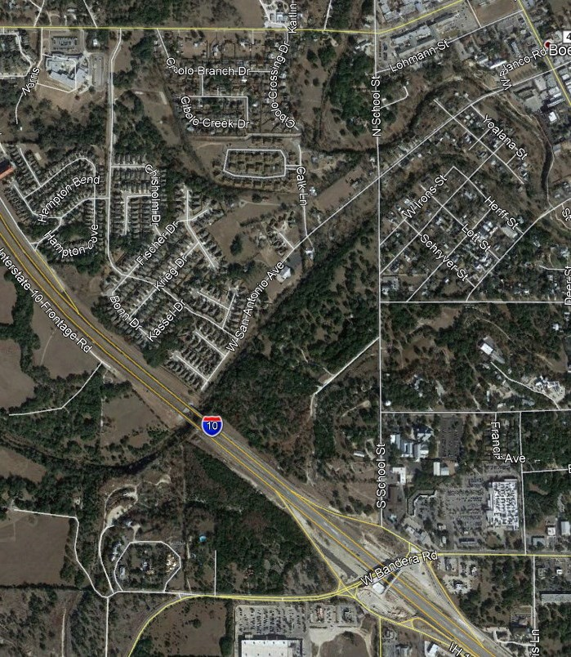
JOHNS ROAD
SCHOOL STREET IMPROVEMENTS
From IH-10 to Frederick Creek
NE Quadrant
Add sidewalk/bike lane and Two Way Left Turn Lane (TWLTL)
ROW needed north of Frederick Creek if capacity improvements
are desired
SCHOOL ST
IH-10
Proposed Typical Section:
Add Sidewalk/Bike Lane and TWLTL in one direction
SH 46
DR
Kendall County, Boerne & Fair Oaks Transportation Committee

Slide 15
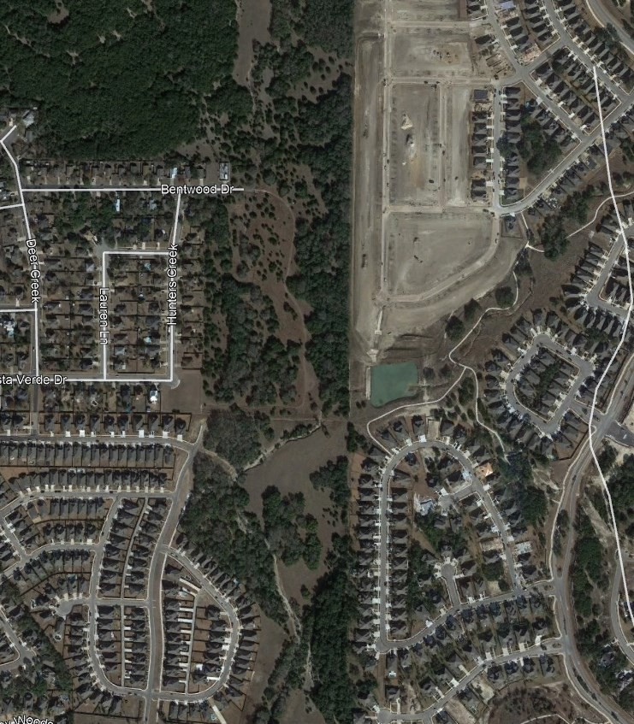
ESPERANZA/BENTWOOD BIKE/WALK PATH
NE Quadrant
Currently there is not a sidewalk/bike path to connect Esperenza and Bentwood neighborhoods to allow stu- dents to walk/bike to Herff Elementary
Would require agreements between HOAs
HERFF ELEMENTARY
BENTWOOD DR
CHAMPION BLVD
SH 46
DRAFT
Kendall County, Boerne & Fair Oaks Transportation Committee

Slide 16
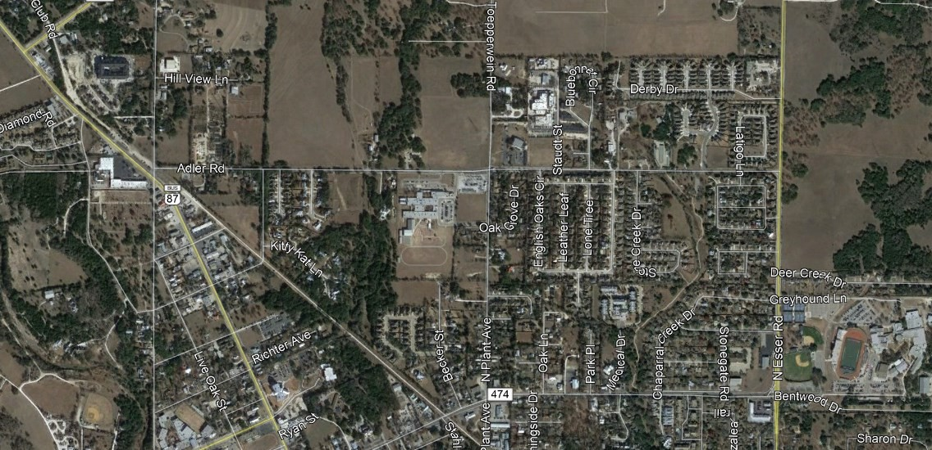
ADLER ROAD IMPROVEMENTS
From Esser Rd to Main Street
NE Quadrant
ADLER ROAD
Short Term:
Add TWLTL
ESSER RD
Long Term:
Add one lane in each direction
Add two way left turn lane (TWLTL)
MAIN ST
Proposed Long Term Typical Section:
DRAFT
Kendall County, Boerne & Fair Oaks Transportation Committee

Slide 17
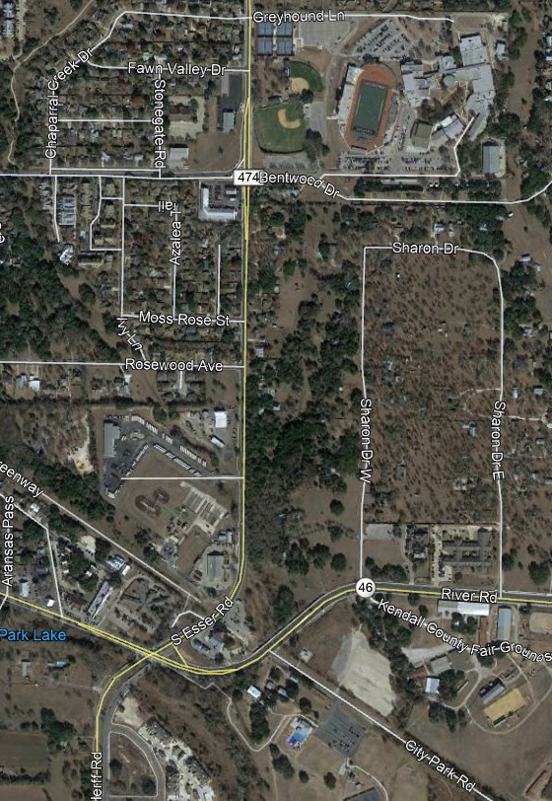
ESSER ROAD IMPROVEMENTS
From SH 46 to Blanco Road
BOERNE HIGH
NE Quadrant
BLANCO RD
Add Sidewalk and Bike Lane as well TWLTL
NO ROW necessary
Parking issues during school events
ESSER RD
Proposed Typical Section:
Add Sidewalk and Bike Lane in one direction
SH 46
DRAFT
Kendall County, Boerne & Fair Oaks Transportation Committee

