Slide 1

Presentation of Demographer’s Study to
Kendall County Transportation Committee
October 22, 2019
B o e r n e I S D

Slide 2

Background - Boerne ISD
B o e r n e I S D
Enrollment Growth 1966 to present
Financial challenges faced since 2005
Projected Growth 2019-2028

Slide 3

Perfect Storm – 2009 to 2011
B o e r n e I S D
Great Recession
Federal Aid temporarily covered gap in state funding 2009-2011
Weak economic recovery = smaller appraisal & tax $ growth
2011 Legislature cut $5.4 billion in K-12 funding
2009 to 2011 - Boerne ISD budget declined by $1.5 million despite gaining 400 new students
Robin Hood payments increased
2009 – 1st year of 2 high schools

Slide 4

Impact of Robin Hood on Boerne ISD
B o e r n e I S D
$109 million in recapture since 2005
13% of our property taxes went to recapture in 2018-19
= $530 for the average homeowner
Necessary frugality

Slide 6
Enrollment Growth 2014-15 to 2019-20
B o e r n e I S D
School Year | Projected Enrollment | Actual Enrollment | # Growth from Prior Year | % Growth from Prior Year
2014-15 |  | 7493
2015-16 | 7902 | 7879 | 386 | 5.2%
2016-17 | 8279 | 8301 | 422 | 5.4%
2017-18 | 8694 | 8688 | 387 | 4.7%
2018-19 | 9126 | 9171 | 483 | 5.6%
2019-20 | 9592 | 9573* | 402 | 4.4%

Slide 7
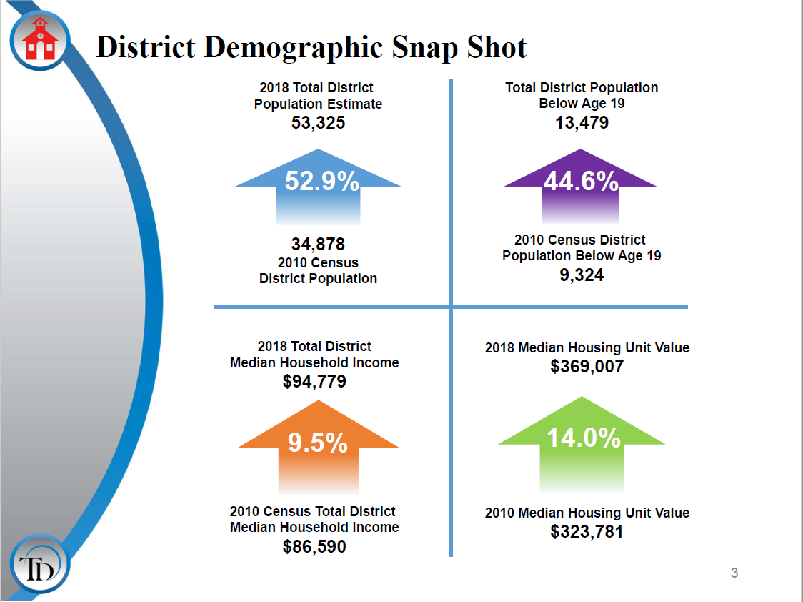

Slide 8
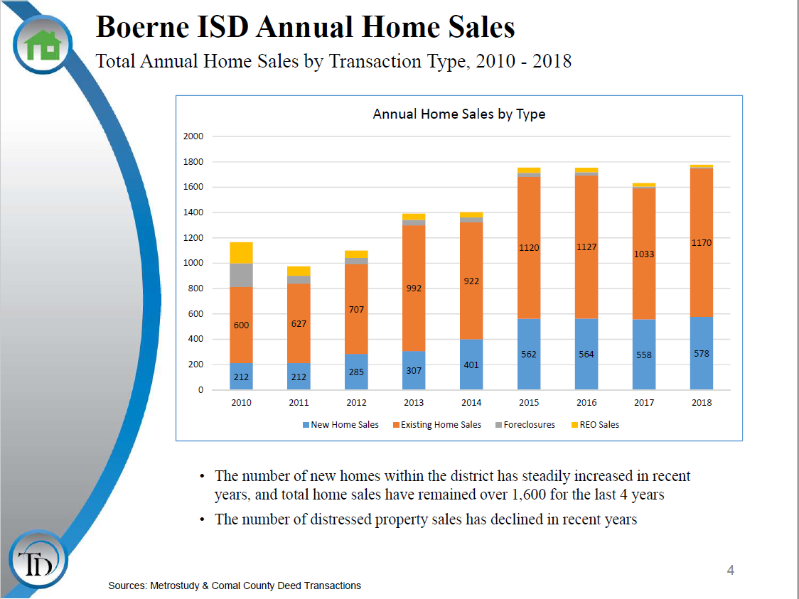

Slide 27

On the road…
Regular Routes
148
Special Routes
60
CTE
6
Daily Routes: 214 x 174 Instructional Days = 37,236
Extra Curricular Trips = 1,100
TOTAL TRIPS 38,336

Slide 28
TOTAL MILEAGE

Slide 29



Total Ridership

Slide 30
Enrollment vs. Riders

Slide 31
Miles per rider per year

Slide 32

Questions & Answers
B o e r n e I S D

